Slide 1
Itinerant Agrarian Justice for Rural Women
October 5, 2023

Slide 2
Rural Women and Land Ownership
2
Women produce
50%
of the food for the world’s population
billion
women live in rural areas
They own less than
20%
or rural farms

Slide 3
= INEQUALITY
- Wealth concentration in men -

Slide 4
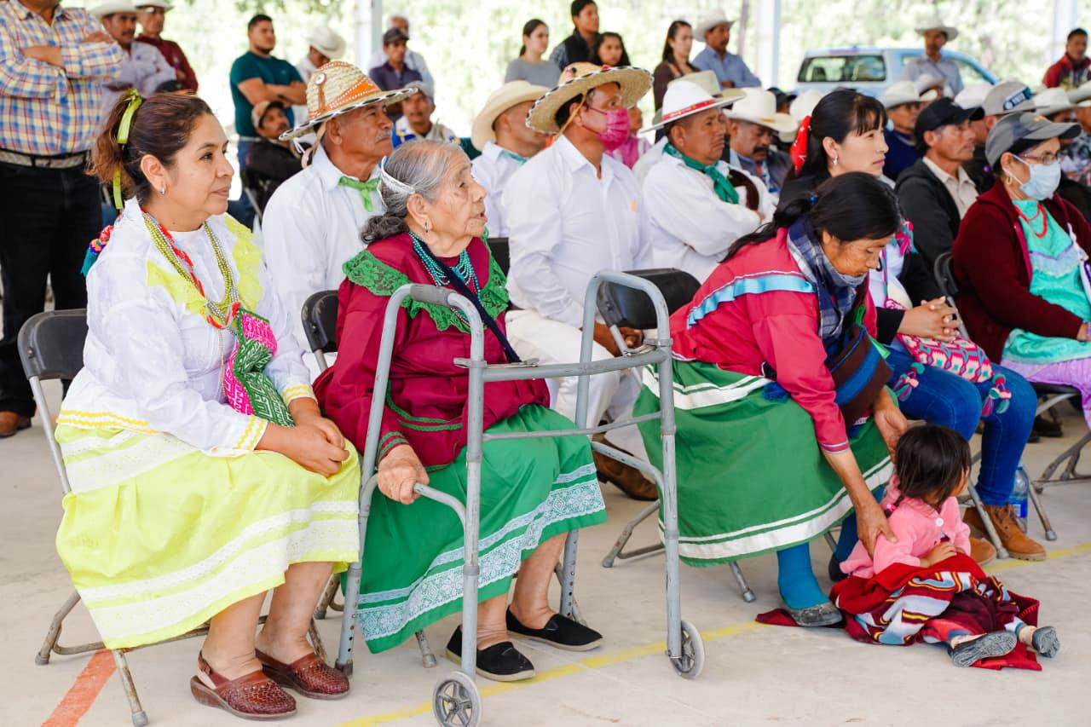
Barriers Women Face in Accessing Justice and Property
Geographic
Digital
Economic
Social
Cultural
Vulnerability

Slide 5
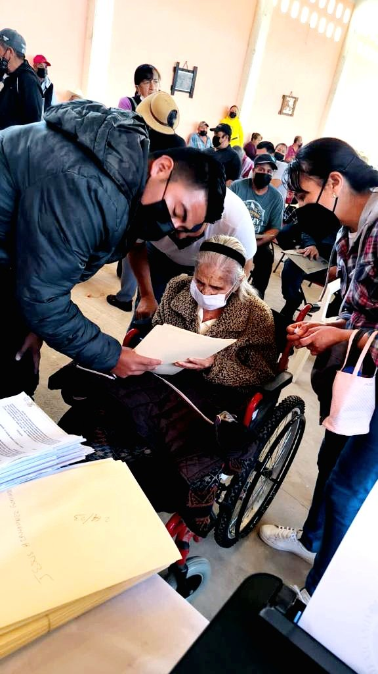
Itinerant Agrarian Justice
for Rural Women
A paradigm shift
Agrarian Courts come to you;
you no longer go to the Courts
Ciudad de México, 19 de julio de 2022

Slide 6
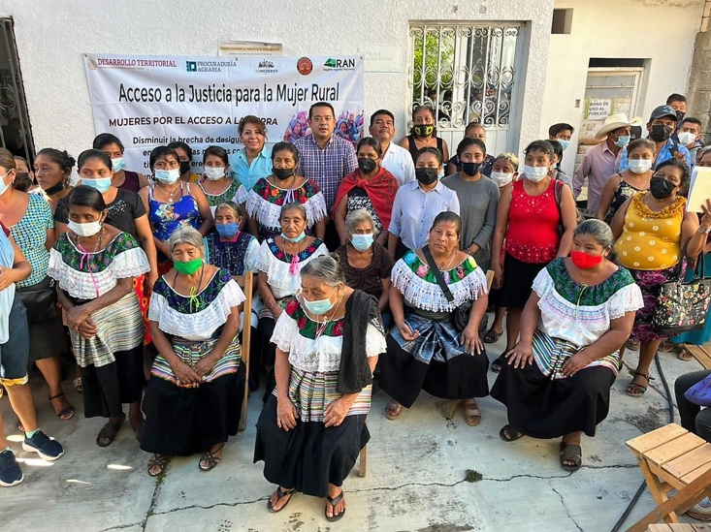
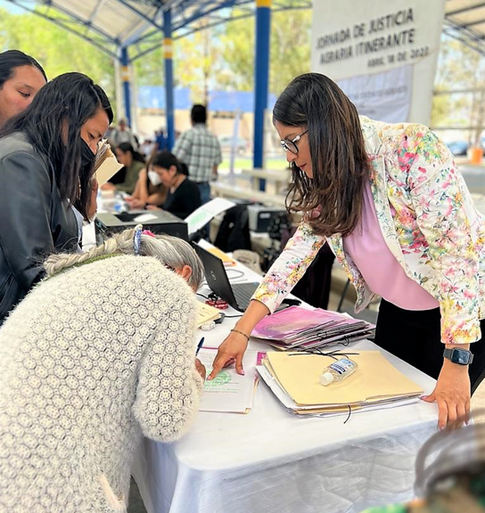
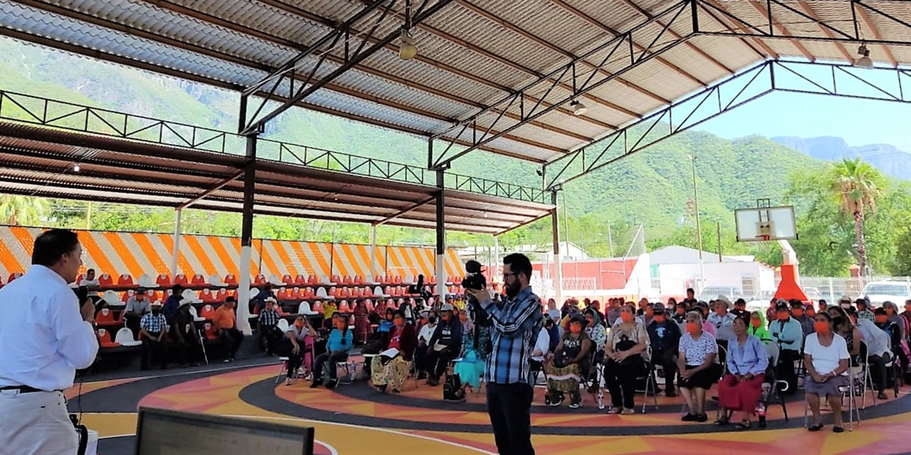
Itinerant Agrarian Justice for Rural Women
Directed to women living in remote areas
The Court installs itself in a school, an ejido house, or a public office
The Magistrates conduct the hearing, offer and admit evidence
Women initiate lawsuits for inheritance or by prescription of possession due to the migration of their spouses
Administrative institutions compile documents of property, possession, and identity
The judgment orders the issuance of their land title for the lands they cultivate.

Slide 7
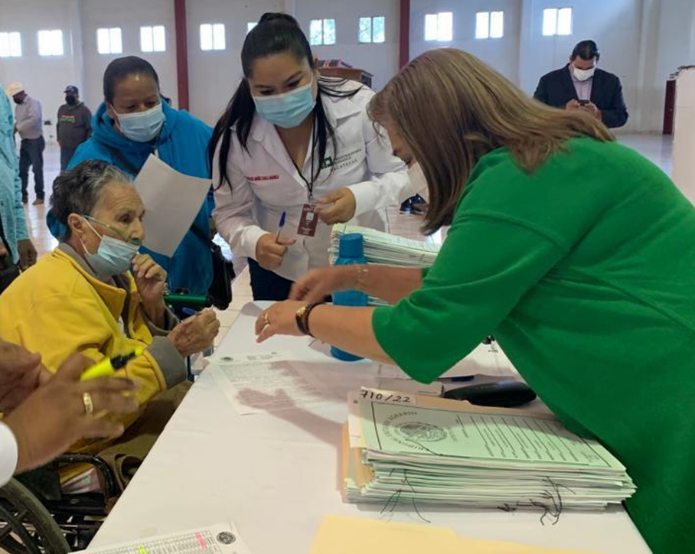
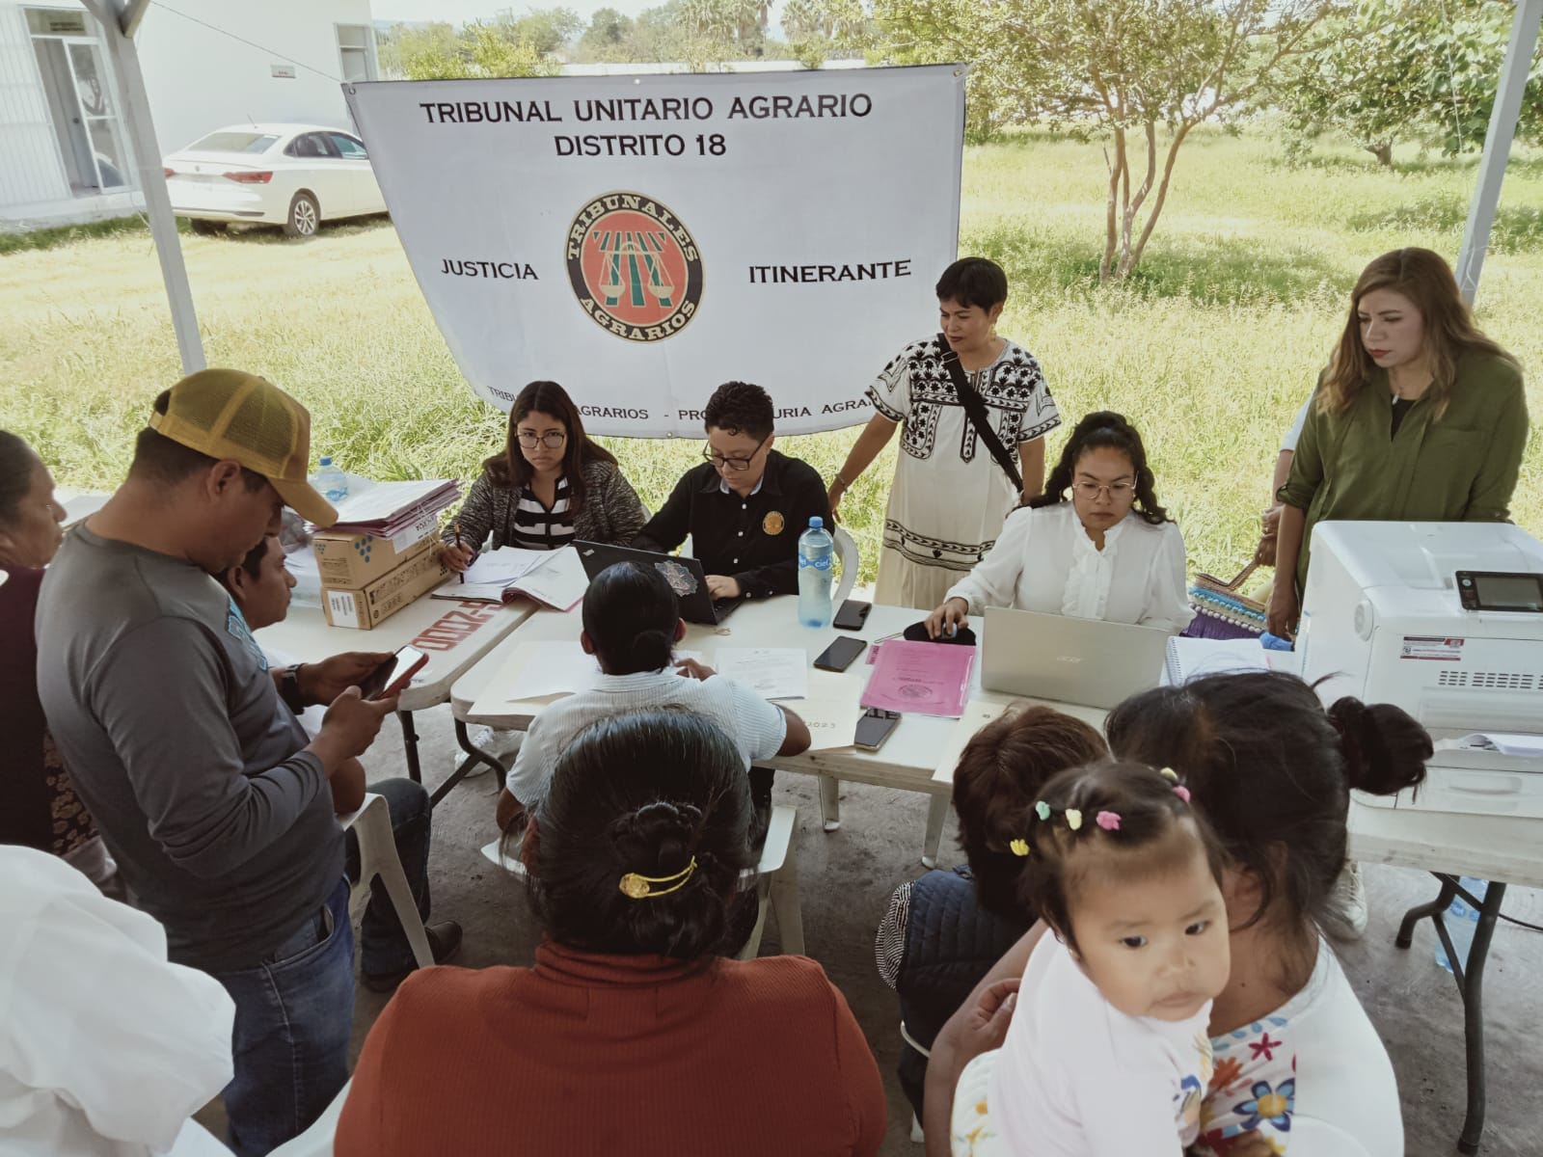
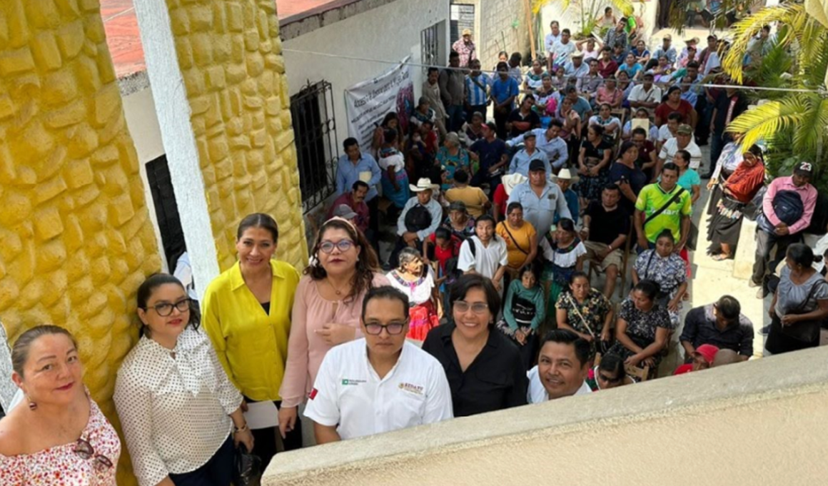
Power Dynamics
For women, land ownership EMPOWERS them.
It grants them autonomy to make their own decisions.

Slide 8
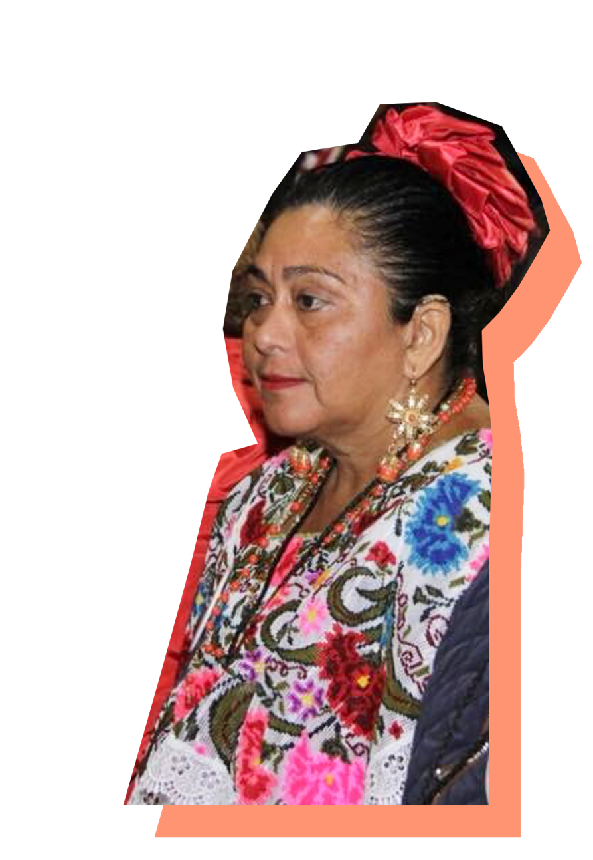
María de la Luz Alba
Maya ethnicity
Ejido: Celestún, Yucatán, México
With her land rights, she was elected as the representative of her ejido.
She promoted ecotourism.
She owns a restaurant where she sells food with recipes dating back 500 years.
Being a widow, losing sight in one eye, and using hearing aids are not obstacles for her.
Today, she is a successful entrepreneur.

Slide 9
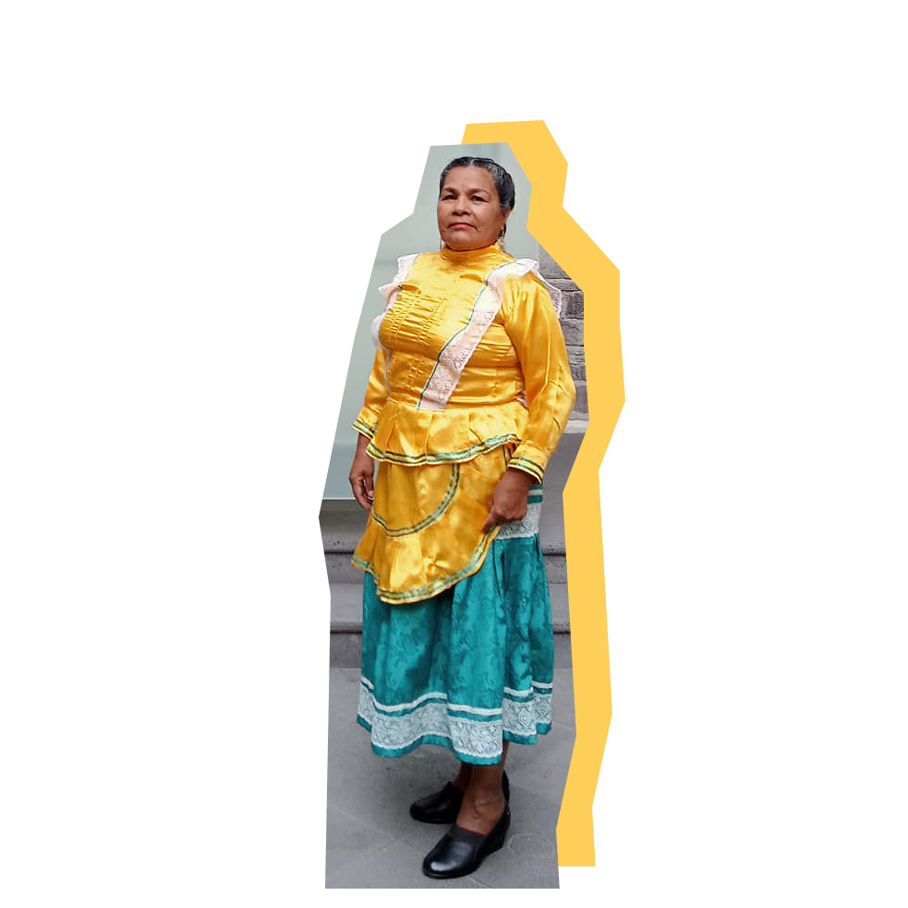
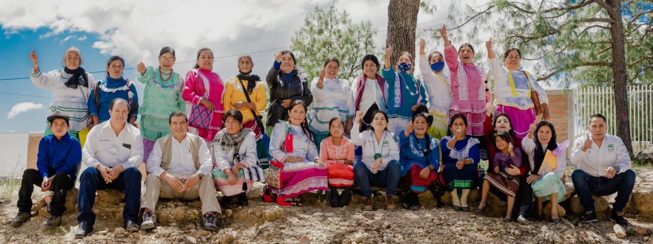
Virginia
Tepehuana ethnicity. Xoconostle, Durango, México
Inherited the land from her father
She is the traditional governor of the Xoconostle community
With the income from her land's cultivation, her two children have become professionals
She advocates for the sustainable management of natural resources and the education of young people

Slide 10
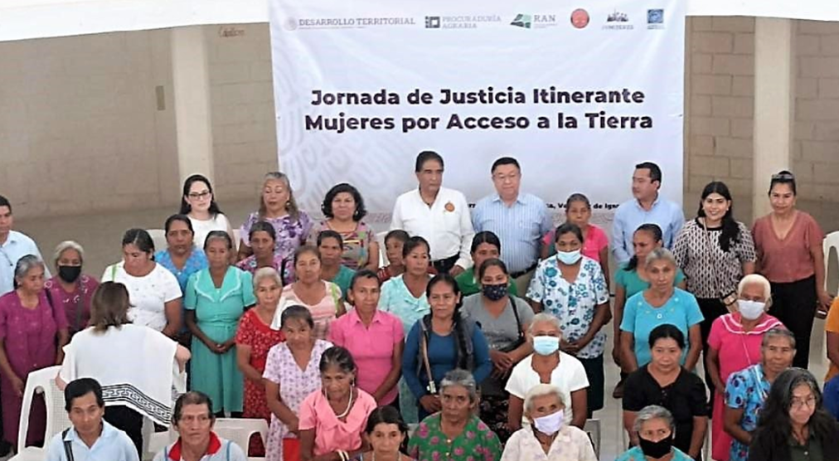
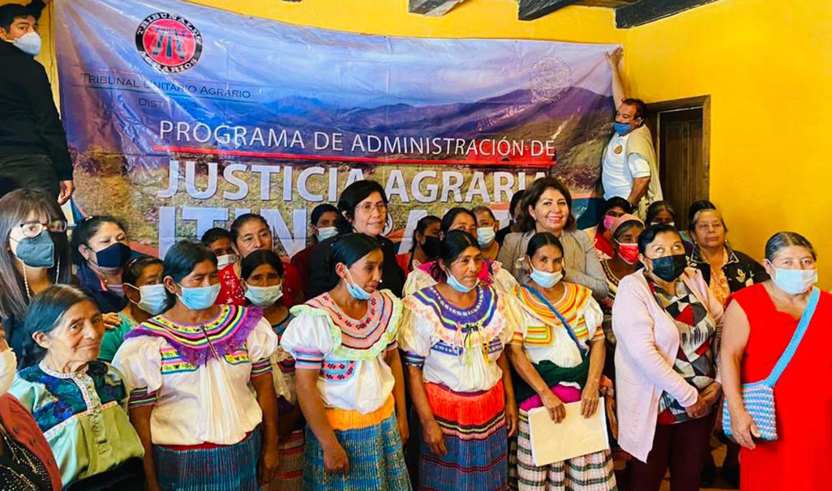
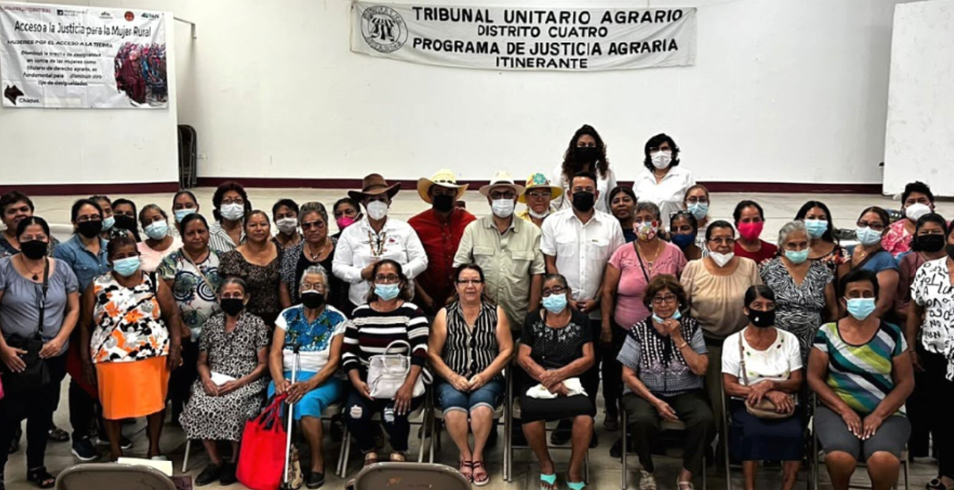
Results 2022
6,000
women have been recognized as
landowners with judgments pronounced
by Agrarian Courts.
15%
of agrarian cases, nearly 1/5, were conducted through Itinerant Agrarian
Justice for Rural Women.

Slide 11
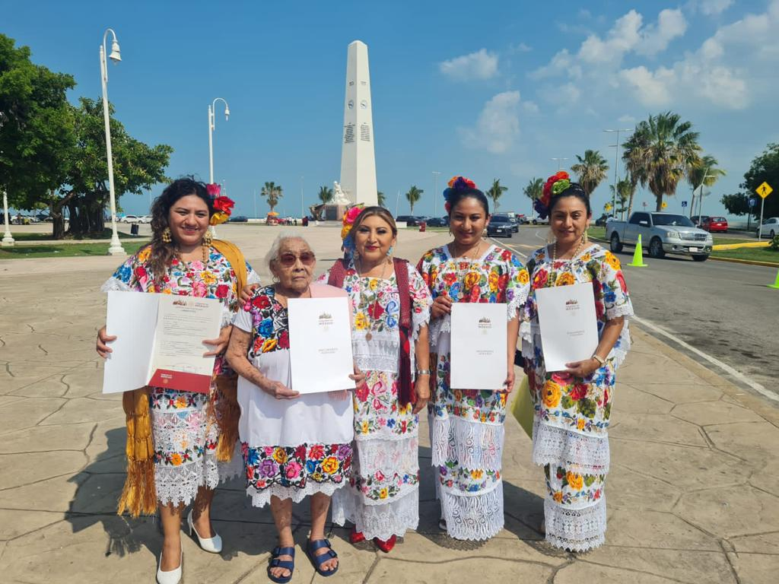
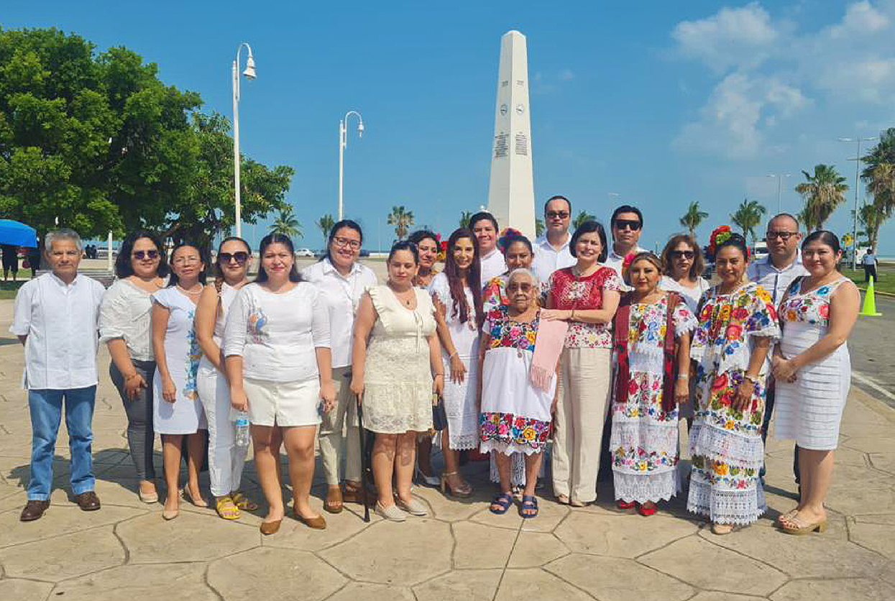
Positive Impacts for Rural Women
Access to justice and effective legal protection
Legal security in their property
Autonomy in decision-making
Increased participation in community life

Slide 12
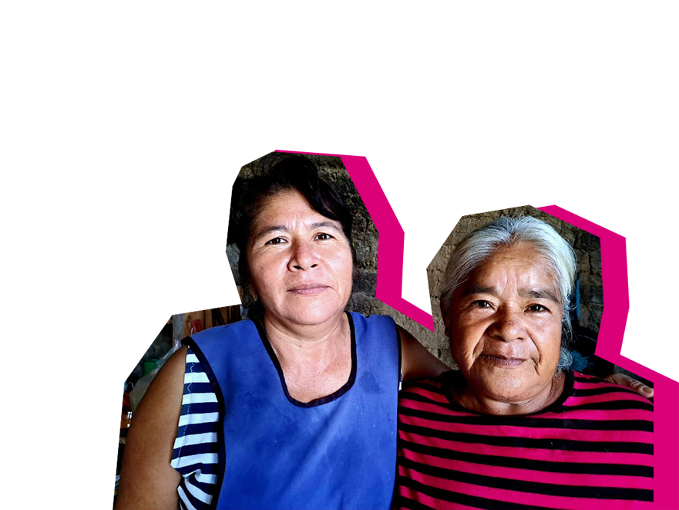
A Rural World in Motion
Women living in rural areas demand to be protagonists of social, political and economic change to build a fairer world with equal opportunities for all people.

Slide 13
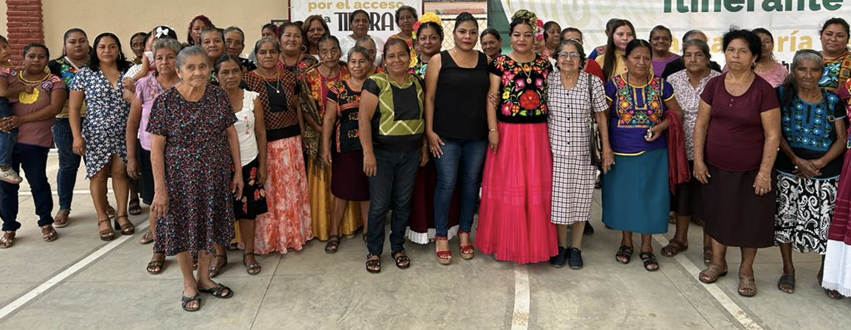
Rural women want to stop being "The Forgotten" and become agents of change.

Slide 14
Maribel C. Méndez de Lara
@TAgrarios
@Maribelmendezd3
Chief Magistrate of Agrarian Courts
@TAgrarios
TribunalesAgrariosOficial
TribunalesAgrariosOficial
Tribunales Agrarios
www.tribunalesagrarios.gob.mx

